Slide 1
PPM3
Product Overview
Notes:
Background can’t be white so it is a challenge to discretely add a logo here

Slide 2
Features
Optimized Workflow for Oral Surgery
Connectivity with Leading EMR Systems

Slide 3
Suited for Mobile Applications
Compact and Light Design
4.5 lbs
Long Battery Life
- 5+ hours Running all parameters
Notes:
Replace “Suited”
Designed?

Slide 4
Benefits
Low Cost of Ownership
Designed, Built, and Serviced in the USA
Three Year Warranty
Notes:
Add flag

Slide 5
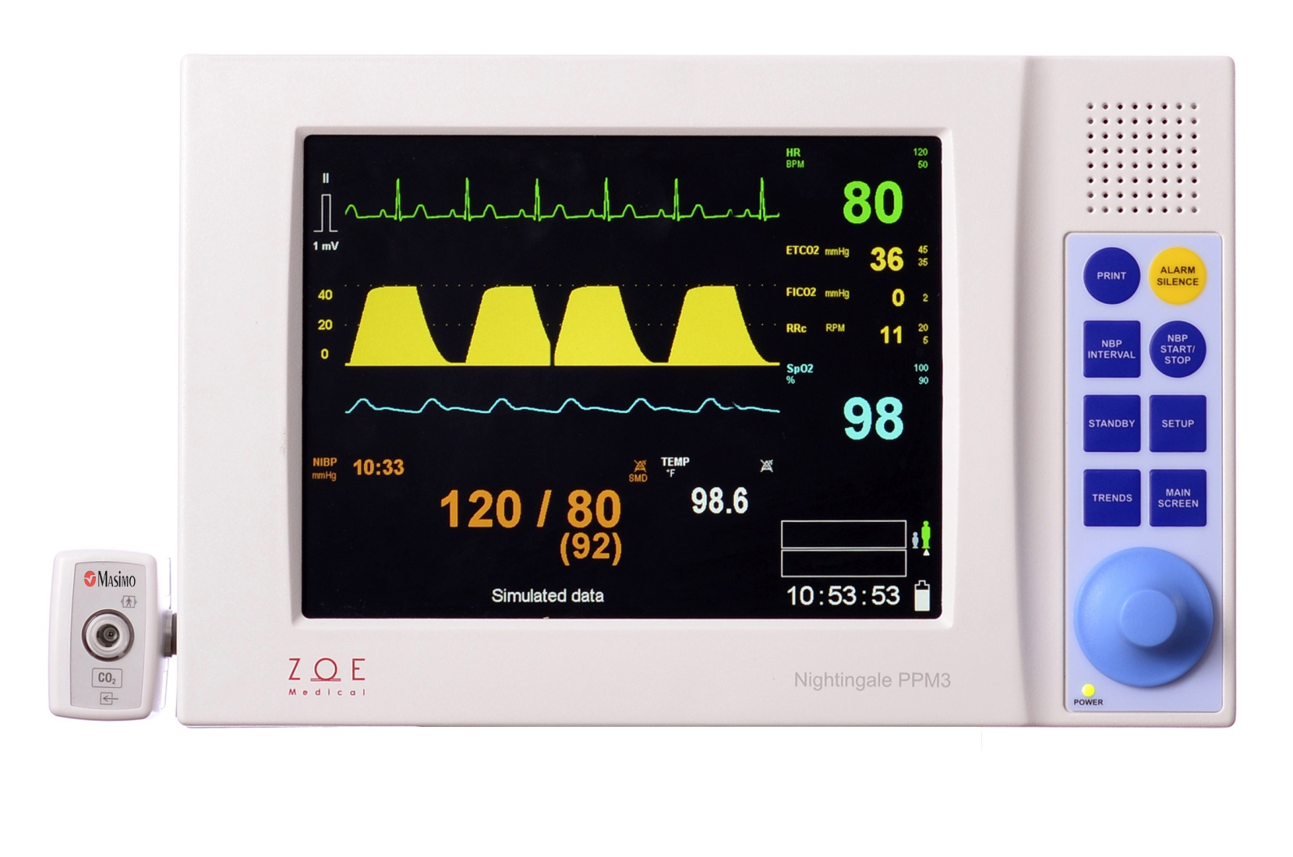
Optimized for Oral Surgery Workflow
CO₂ waveform provides respiratory status with a quick glance
Pulse rate from ECG, SpO₂, or BP (auto-selected)
Connects to major EMR systems
Periodic BP measurements started with a single key press

Slide 6
Optimized for Oral Surgery Workflow
Audio blip provides both ECG Heart Rate + SpO₂ Saturation without needing to look at device
Color-Coded parameters + waveforms
High brightness display with wide viewing angle

Slide 7
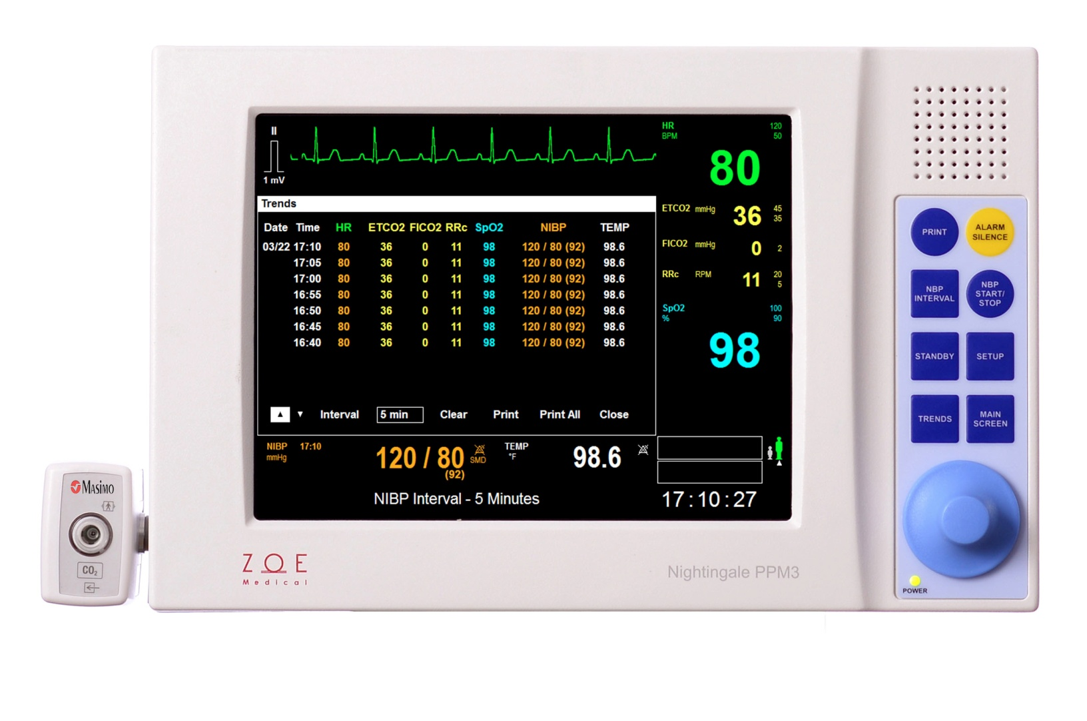
Optimized for Oral Surgery Workflow
Trend data stored every minute
Printed reports will match displayed intervals
Print vs. print-all functionality
Trends displayed at intervals- 1m, 5m, 15m, 1h, or 5h
One touch to view trends

Slide 8
Low Cost of Ownership
Cost Effective CO₂ accessories
- Nomoline adapter is more affordable than other water traps
- Device works with Luer Lock and lower-cost cannulas
Durable ECG cable
- Kevlar reinforced
Works with reusable ECG wrist clips
- vs disposable electrodes
Notes:
Double check 336 hours
Connection type
“Don’t advocate wrist clips”- tom
- 10 second warm up time

Slide 9
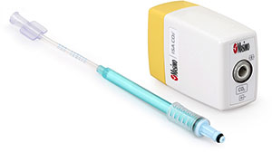
Best in Class CO₂
Masimo Phasein
No warm up time required
Accommodates all patient types
Rugged Design
No calibration required

Slide 10
Parameters and Technology Options
Standard
ECG
Pulse Oximetry (SpO₂)
Non-Invasive Blood Pressure (NIBP)
Temperature
Optional
Capnography (CO₂)
Invasive Pressure

Slide 11
Mounting Solution Options
Works with most standard mounting solutions (GCX)
Roll Stand
Table Stand
Wall Mount
Bed Rail

